Slide 1
SENTIMENT ANALYSIS
ARTIFICIAL INTELLIGENCE PROJECT
NAAN MUDHALVAN PHASE-4

Slide 2
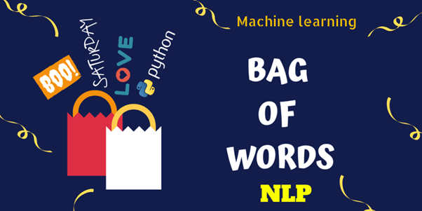
KEY ACTIVITIES
Certainly, let's continue building the sentiment analysis project by covering key activities such as
feature engineering
model training
Evaluation
We have the pre-processed data from the twitter airline dataset derived by using tweepy library. Now, we'll focus on using a popular machine learning model for sentiment analysis.
The popular machine learning model we are going to use int his model building are
Bag-Of-Words for feature extraction
Support Vector Machine for Hyperparameter Tuning

Slide 3
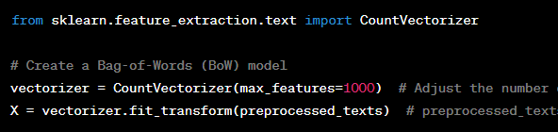
FEATURE ENGINEERING
Feature engineering is the process of selecting or creating relevant features that can improve the performance of your sentiment analysis model. For this example, we'll use a simple bag-of-words (BoW) model as our feature representation.
Now, we have created Bag-Of-Words model using the preprocessed data that we already stored in
`preprocessed_texts` and got the vectorized data in variable “X”.

Slide 4
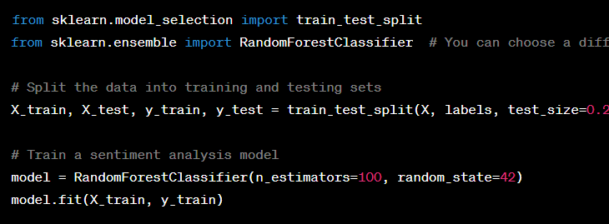
MODEL TRAINING
In this step, you'll train a machine learning model to predict sentiment labels based on the features we've engineered.
For that we’re going to import two libraries from sklearn library to perform model training by splitting the data and perform randomforestclassifier.

Slide 5
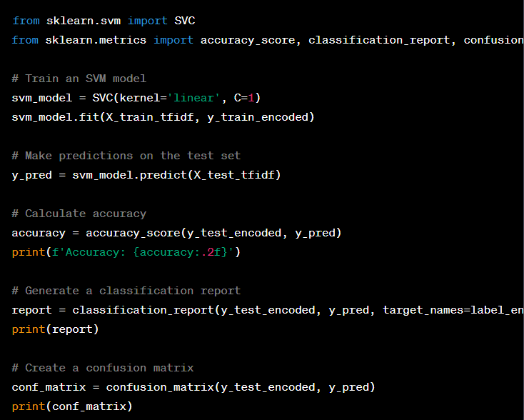
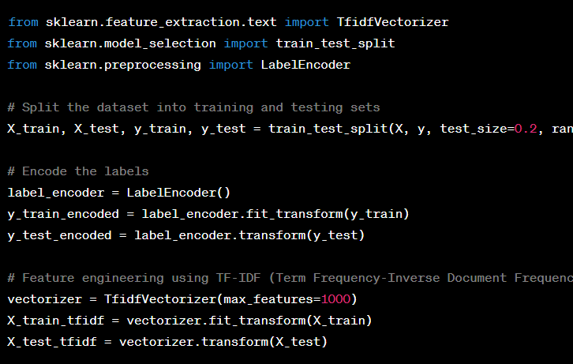
MODEL TRAINIING USING SVM
Preprocessing the data
SVM classifier on preprocessed data

Slide 6
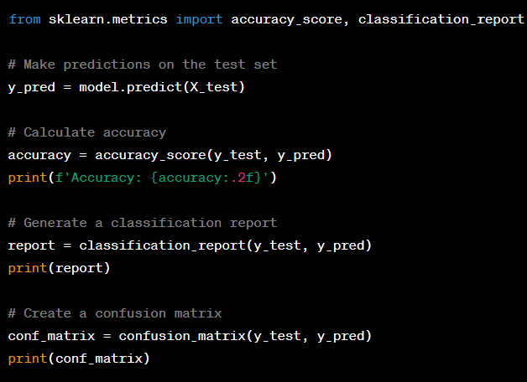
MODEL EVALUATION
Model evaluation is a critical step in assessing the performance of your sentiment analysis model. It helps you determine how well your model is doing in classifying sentiments and provides insights into its strengths and weaknesses. There are various evaluation metrics and techniques you can use to assess your model's performance.
It's essential to choose evaluation metrics that align with your project's goals. For instance, if your primary concern is identifying negative sentiments accurately, you might prioritize recall. On the other hand, if false positives have significant consequences, you may prioritize precision.
Remember that a single metric is often insufficient to gauge a model's overall performance. You should consider a combination of metrics, the specific context of your project, and the trade-offs between precision and recall, as well as other factors that align with your objectives. Additionally, consider the ethical implications of your model's predictions and their potential impact on users and society.

Slide 7
HYPERPARAMETER TUNING
You can further improve your model's performance by tuning hyperparameters. You might use techniques like grid search or random search to find optimal hyperparameters.
Deployment:
Once your model is trained and performing well, you can deploy it as part of your sentiment analysis tool or application. For real-time analysis, consider building a web-based interface that takes user input and uses your model to provide sentiment analysis results.
Continuous Improvement:
Collect user feedback and data to continuously improve your model. You can retrain it with updated data and refine your preprocessing and feature engineering based on new insights.
Ethical Considerations:
Always consider ethical aspects, privacy, and fairness when building a sentiment analysis tool. Ensure that your system respects user privacy and doesn't discriminate based on race, gender, or other protected attributes.

Slide 8
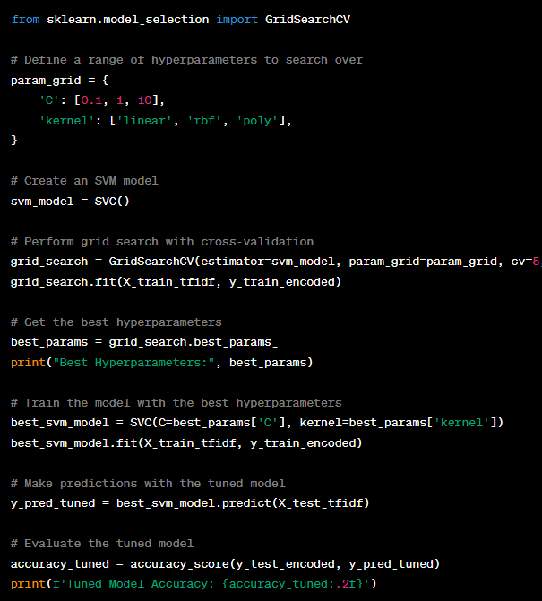
HYPERPARAMETER TUNING
We define a param_grid dictionary that specifies the hyperparameters to be tuned. In this example, we're tuning the C parameter (regularization strength), kernel (kernel function), and gamma (kernel coefficient).
We create an SVM model using SVC().
We use GridSearchCV to perform the grid search. This function takes the model, the parameter grid, cross-validation settings (e.g., cv=5 for 5-fold cross-validation), the scoring metric (scoring='accuracy'), and verbose=2 to display progress.
The best hyperparameters are obtained using grid_search.best_params_.
We then train a new SVM model with the best hyperparameters.
The tuned model is used to make predictions on the test set, and accuracy is calculated to evaluate its performance.

Slide 9
THANKING YOU

